Slide 1
ANDROID APPLICATION DEVELOPMEMT
BY
AKSHAY G RAO
1BG15CS010
INTERNAL GUIDE EXTERNAL GUIDE
Namitha S J Adgaonker Shashank
Professor, Dept. of CSE, Trainer and Senior Android Developer
BNMIT Azure Skynet Solutions Pvt. Ltd.

Slide 2
CONTENTS
AZURE SKYNET SOLUTIONS PVT. LTD.
ABOUT THE DEPARTMENT
TASK PERFORMED
REFLECTION NOTES

Slide 3
AZURE SKYNET SOLUTIONS PVT. LTD.
Overview of the company
ISO 9001:2015 certified service provider.
The company’s diverse and talented employees are committed to help businesses, governments and educational institutions to plan and run successful security programs through the right combination of products , services and solutions related to security program strategy, enterprise risk and consulting in multiple technologies.
Founded in 2014,the company has served more than 120 clients of various sizes across multiple industries.
The company’s national awareness program includes BrainTech Championship and Cyber Security program.

Slide 4
Services
VULNERABILITY ASSESSMENT-The process defines, identifies, and classifies the security holes (vulnerabilities) in a computer, network or communications infrastructure.
NETWORKING PENETRATION TESTING-The primary objective for a network penetration test is to identify exploitable vulnerabilities in networks, systems, hosts and network devices (ie: routers, switches) before hackers are able to discover and exploit them.
WEB APPLICATION PENETRATION TESTING-Comprehensively assess web applications for vulnerabilities that can lead to unauthorized access or data exposure

Slide 5
ABOUT THE DEPARTMENT
Some of the disciplines for which Azure Skynet provides internship are –
Ethical Hacking
Android Application Development
Machine Learning
Digital Marketing
Networking
The internship was done in the field of Android Application Development.

Slide 6
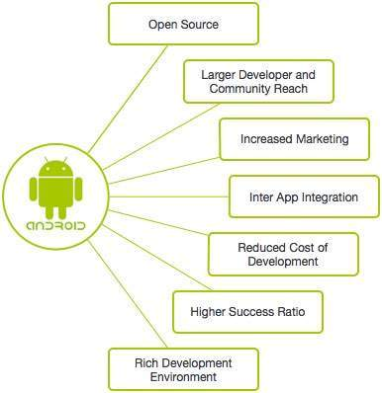
Overview of Android
Open Source Linux based OS for Smartphones and Tablets.
Android offers a unified approach to application development for mobile devices which means developers need only develop for Android, and their applications should be able to run on different devices powered by Android.
Android 1.0 was Released in 2008 and the current version of
Android, Android 9.0 Pie, was released in 2018.
Android’s source code is available under free and open source
licences.

Slide 7
Some of the salient features of Android are:
Beautiful UI- Android OS basic screen provides a beautiful and intuitive user interface.
Connectivity- Supports GSM/EDGE,CDMA, EV-DO, UMTS, Bluetooth, Wi-Fi, LTE, NFC and Wi-Max.
Storage- SQLite, a lightweight relational database is used for data storage purposes.
Media Support- H.263,MPEG-4 SP,WAV,JPEG,PNG,MP3,GIF,MIDI,BMP and many more.
Messaging Service Support- Supports SMS and MMS services.
Multi-touch- Android has native support for multi-touch which was initially made available in HTC hero.
Multi-tasking- Allows users to jump from one task to another and same time various applications can be run simultaneously.

Slide 8
Developing applications for Android
Developed using Java or Kotlin language using Android Studio, the current default IDE for Android Application Development.
Apps developed can be packaged easily and sold out through a store. Ex: Google Play Store.
Android Package Kit (APK) - Package file format used by the Android OS for distribution and installation software of mobile apps, just like Windows’ .exe file.
APK files are generated using Android Studio.
There is a diverse group of Android developers in India, who have developed various education and enterprise applications.

Slide 9
TASK PERFORMED
1. Basics of Android Application Development –
Layout can be designed in a drag and drop manner in the design tab of android studio.
Layout contains elements like radiobuttons, checkboxes, buttons etc..
Creation of Java files to listen to events generated by the elements in layouts.
Send emails and make calls directly from app by taking user permissions.
Working with SQLite for creating and managing databases to store user data.
Load contents from a remote database using Firebase services.
Using Firebase services for user authentication ,user data storage and downloading multimedia content.

Slide 10
2. The application developed during the internship are –
Detection of sensors present in our respective phones-
Involves reading various sensor values which is embedded in smartphones such as light sensor , proximity sensor, accelerometer, gyroscope etc..
A simple shopping application-
Admin and customer portal is provided in this shopping application.
Customer has signup and login options. When he registers, an OTP is sent to the registered phone number and a verification email is sent to his email Id using FireBase Phone Auth service.
Only upon verification of phone number and email Id, he is allowed to login to the application.
User authentication and session management is done using Firebase Authentication.
Displaying the products list with price and description.
All product details are stored in FireStore database provided by Firebase and is fetched upon demand from the external server to populate the product listings in the shopping application.

Slide 11
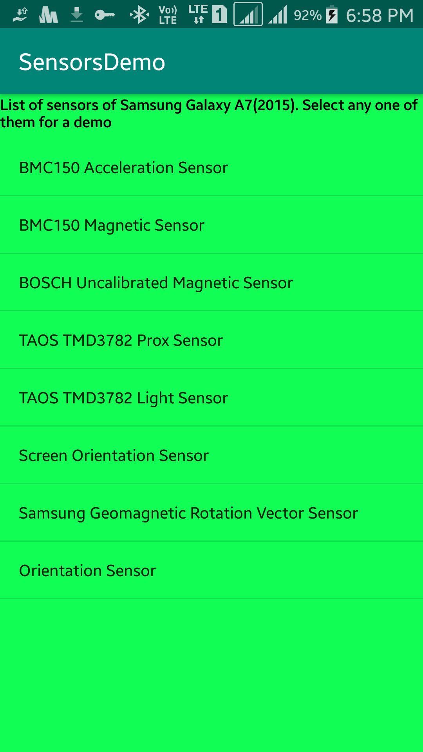
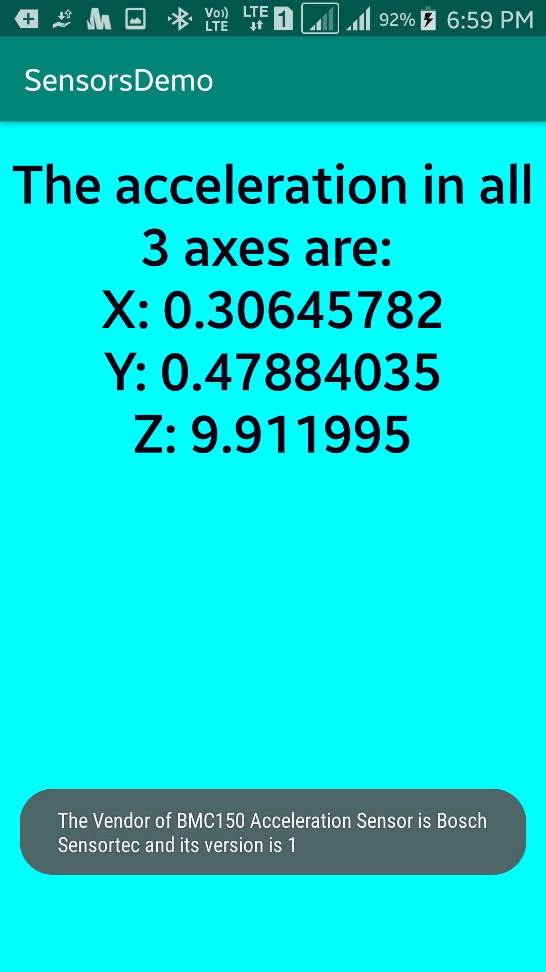
Sensor Detection
Home Page
Accelerometer Demo

Slide 12
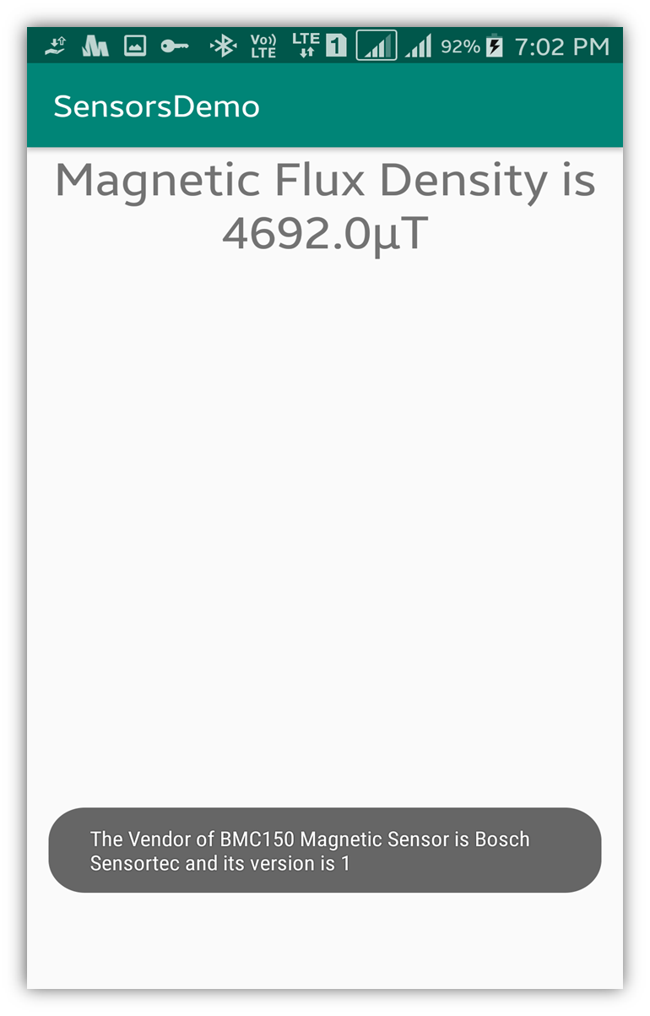
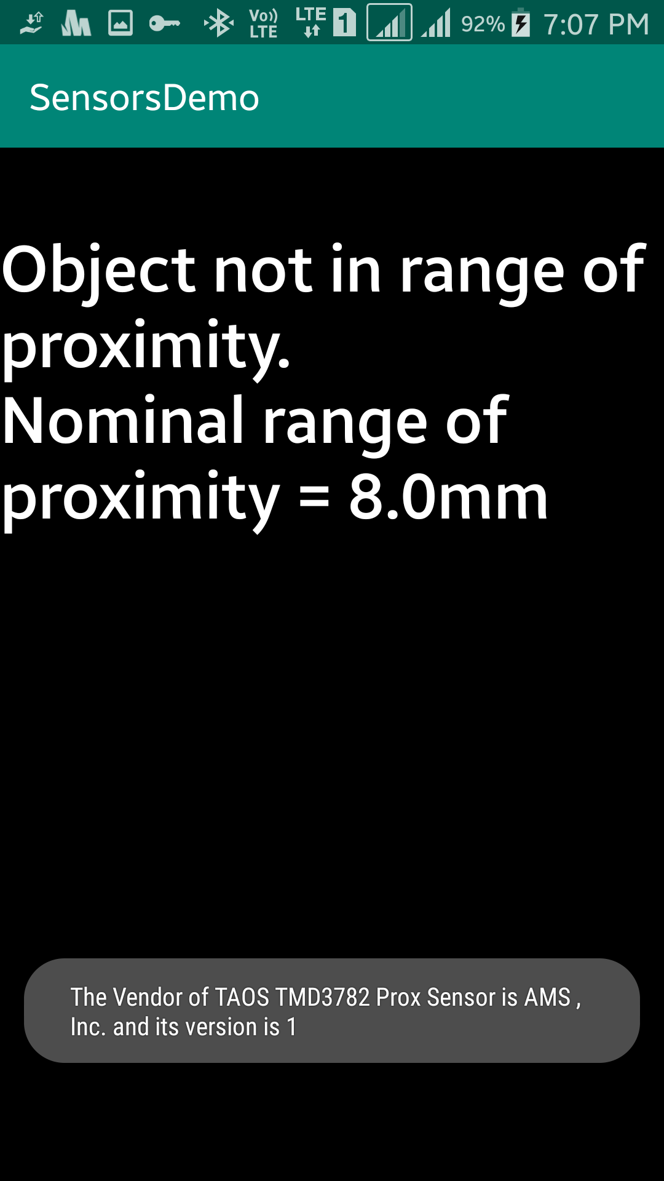
Sensor Detection
Proximity Sensor Demo - 1
Calibrated Magnetic Sensor Demo

Slide 13
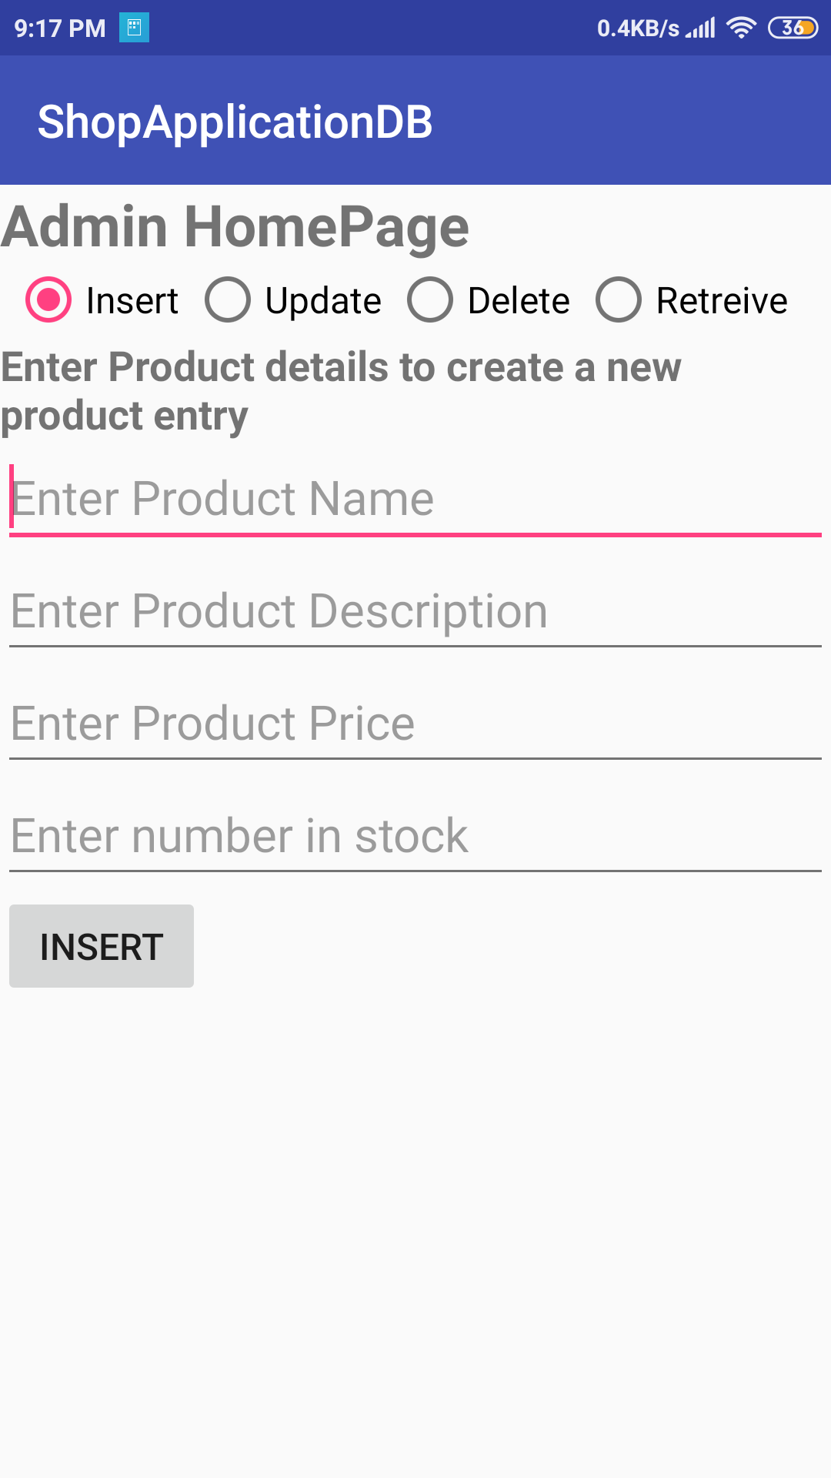
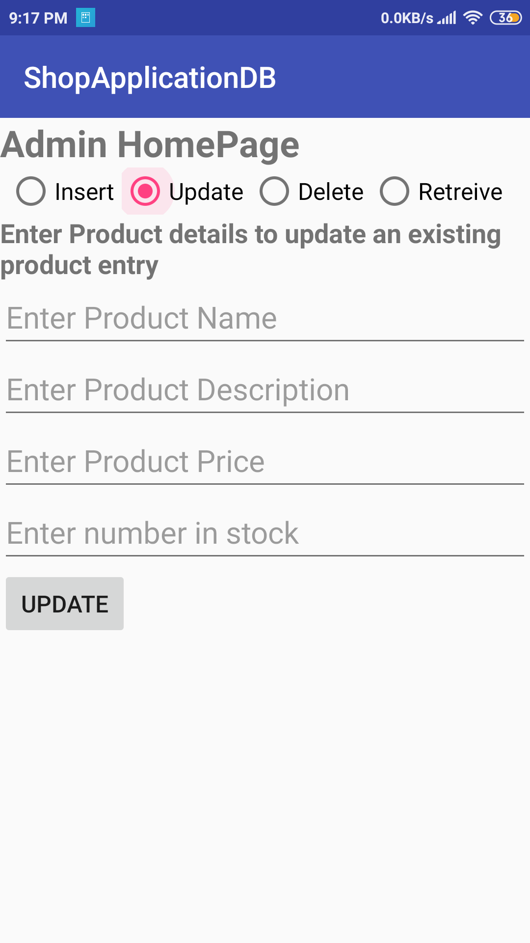
Shopping Application:
Admin Page : Update product details in FireBase database
Admin page : Insert products into FireBase database

Slide 14
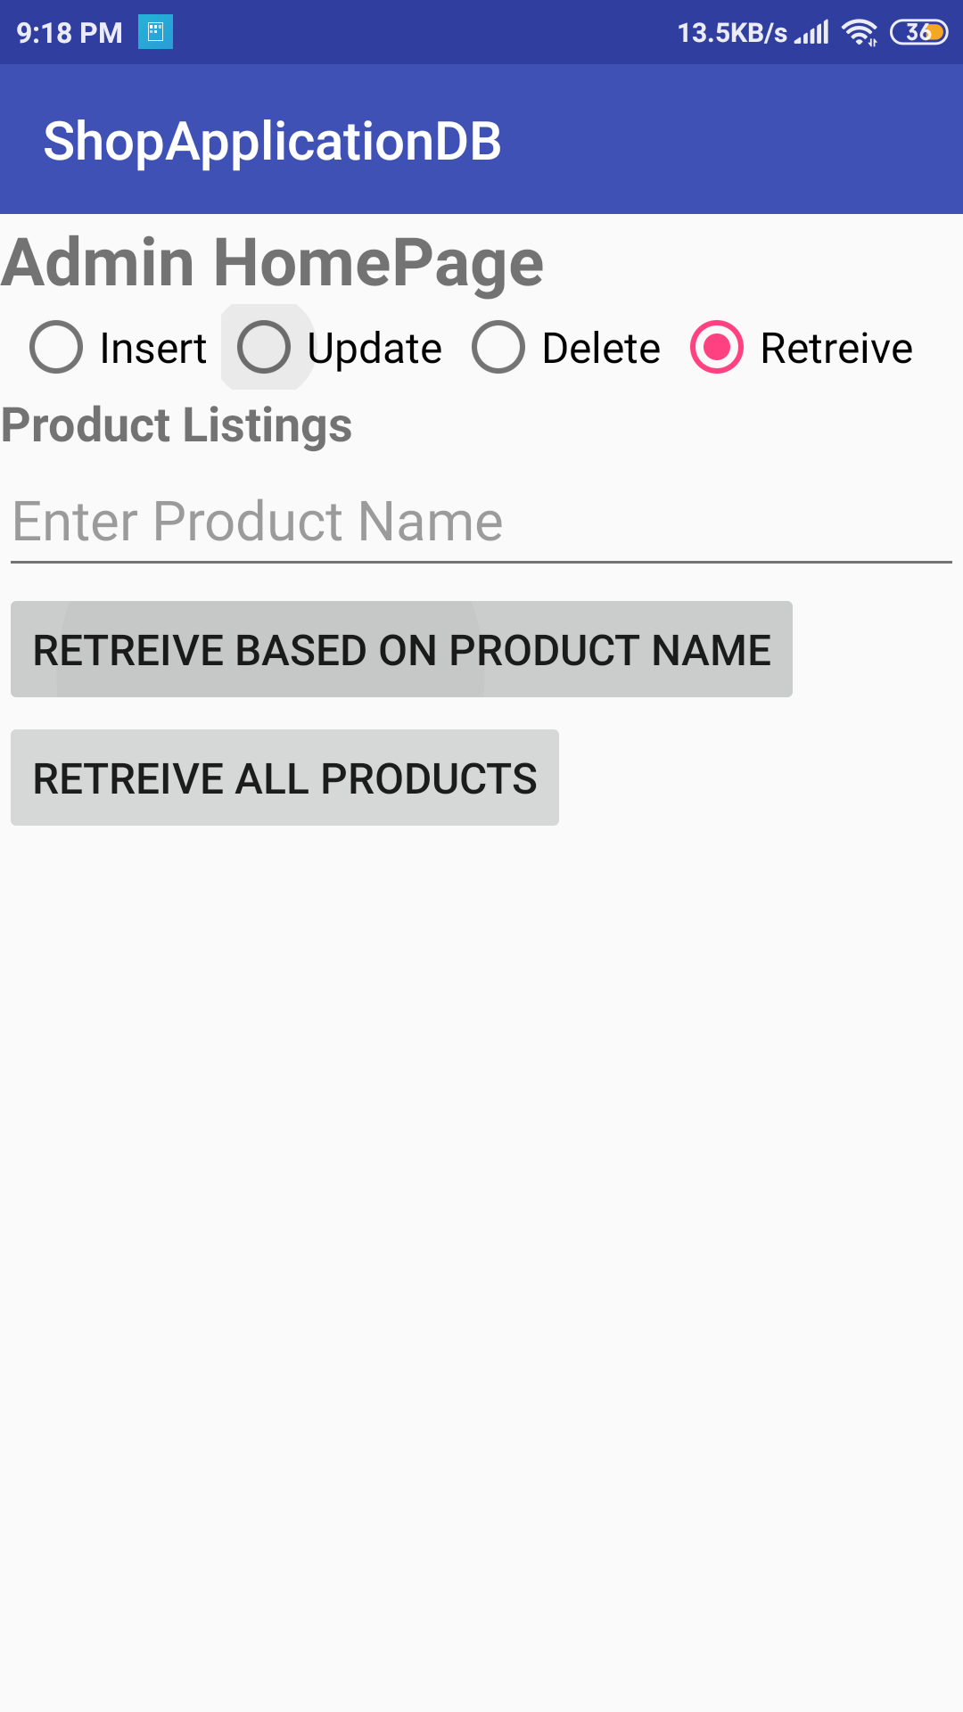
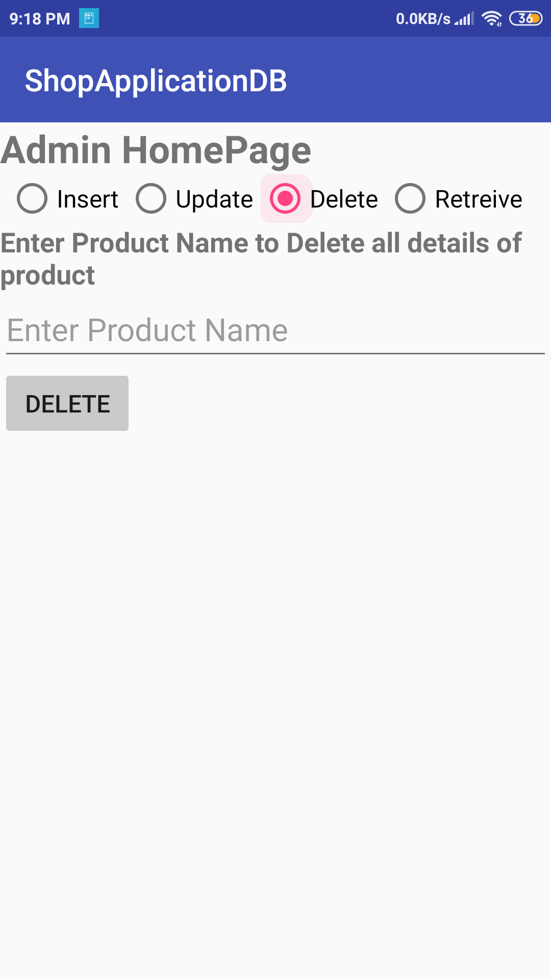
Shopping Application:
Admin page : Retrieve products from FireBase database
Admin Page : Delete products from FireBase database

Slide 15
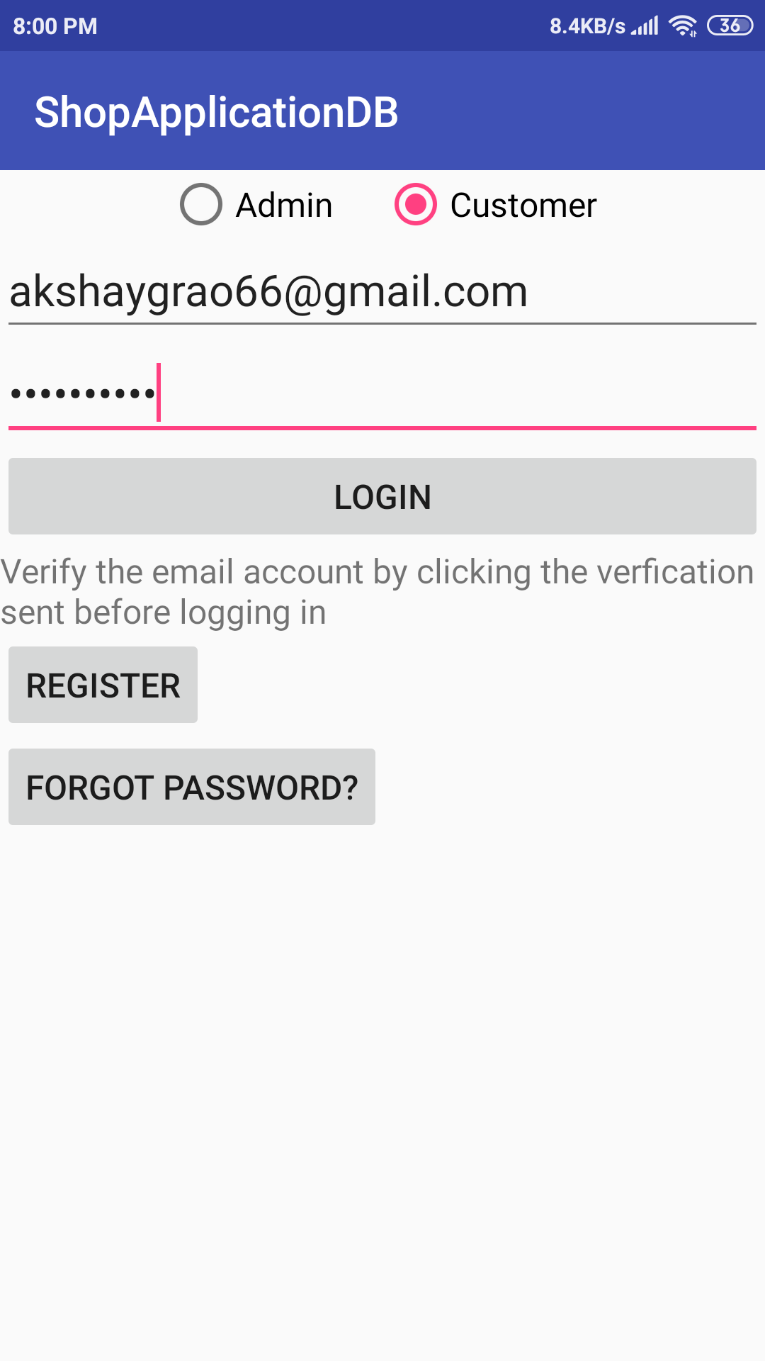
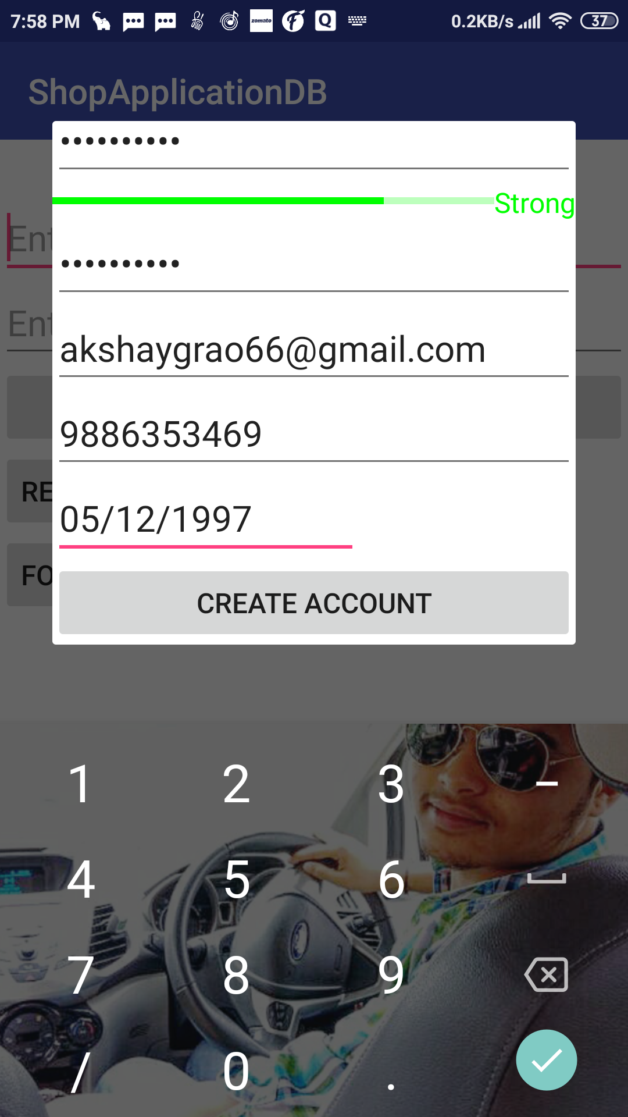
Shopping Application:
Application home page allows login only for verified users
Registration Popup with password strength indication

Slide 16
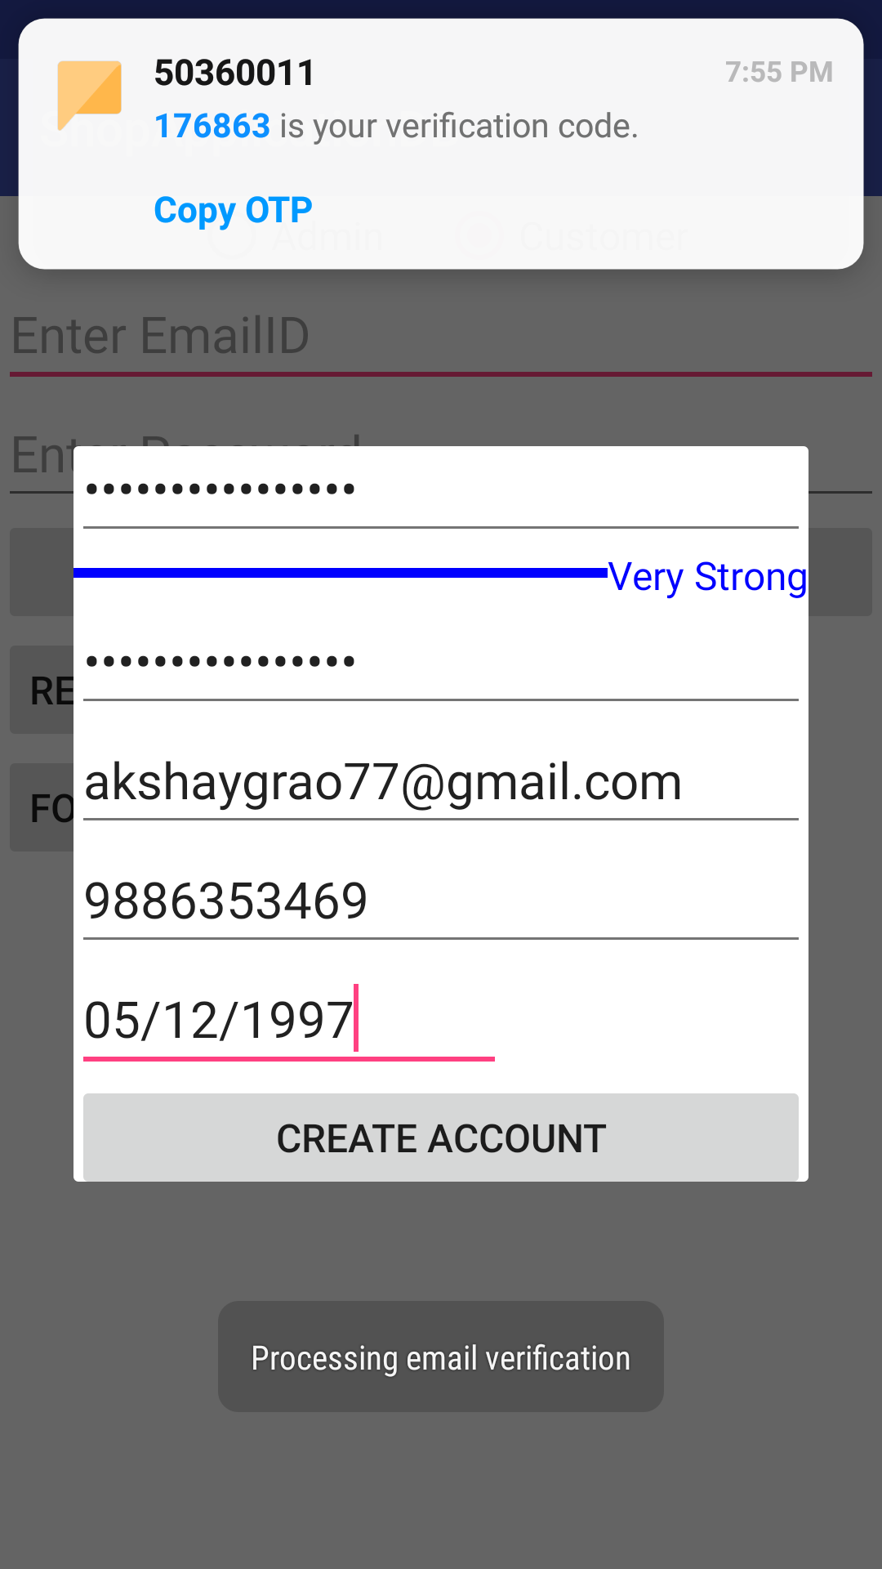
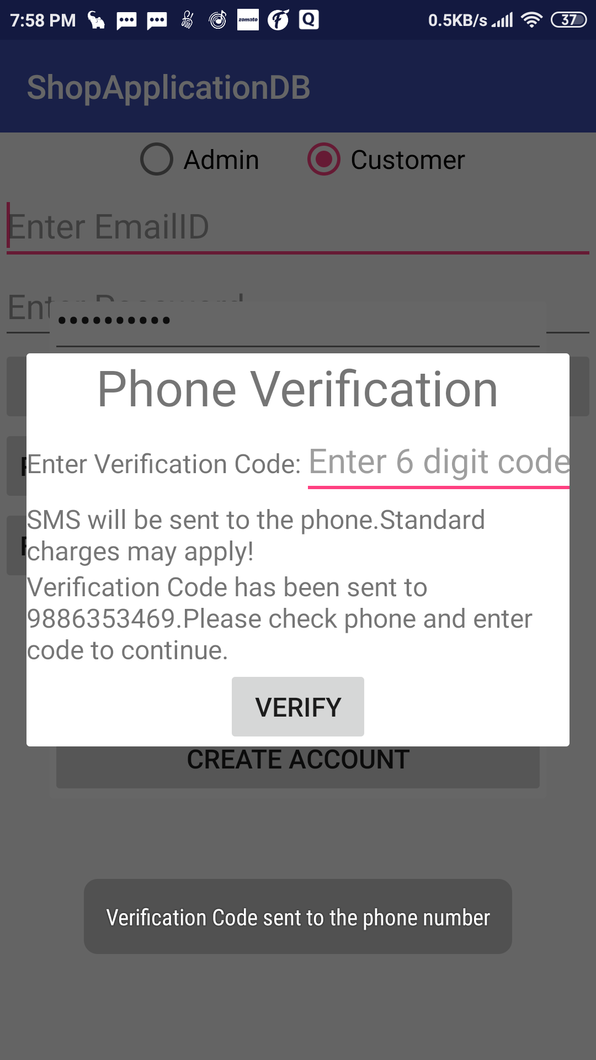
Shopping Application:
OTP based phone number verification
OTP received ,verified automatically and sending email verification

Slide 17
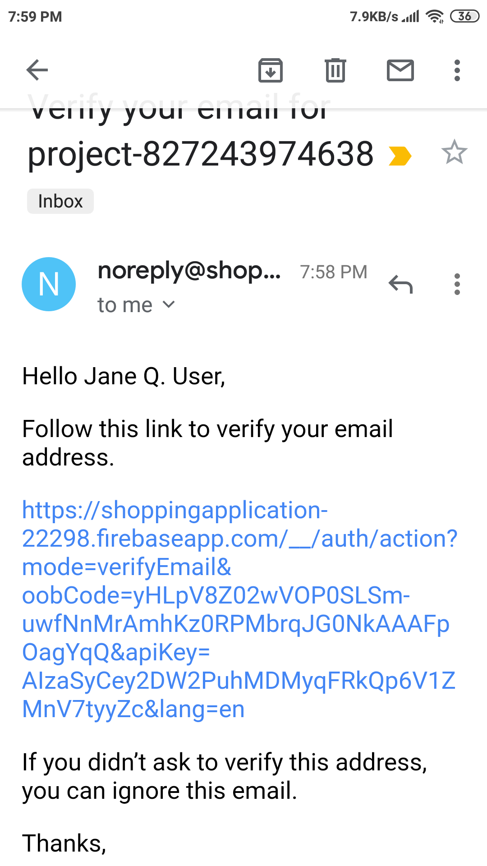
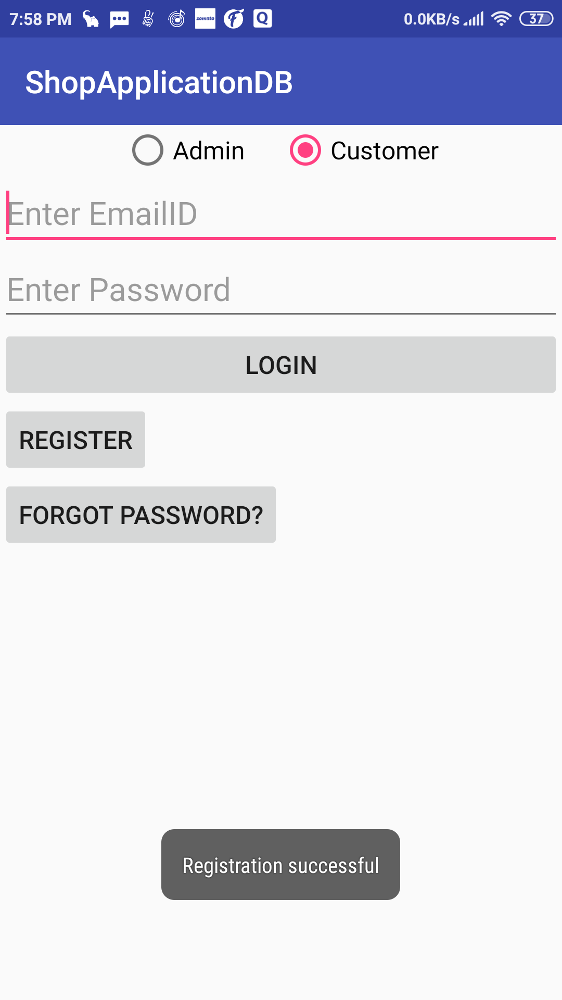
Shopping Application:
Verification link sent to the registered email ID
Registration Successful upon phone authentication

Slide 18
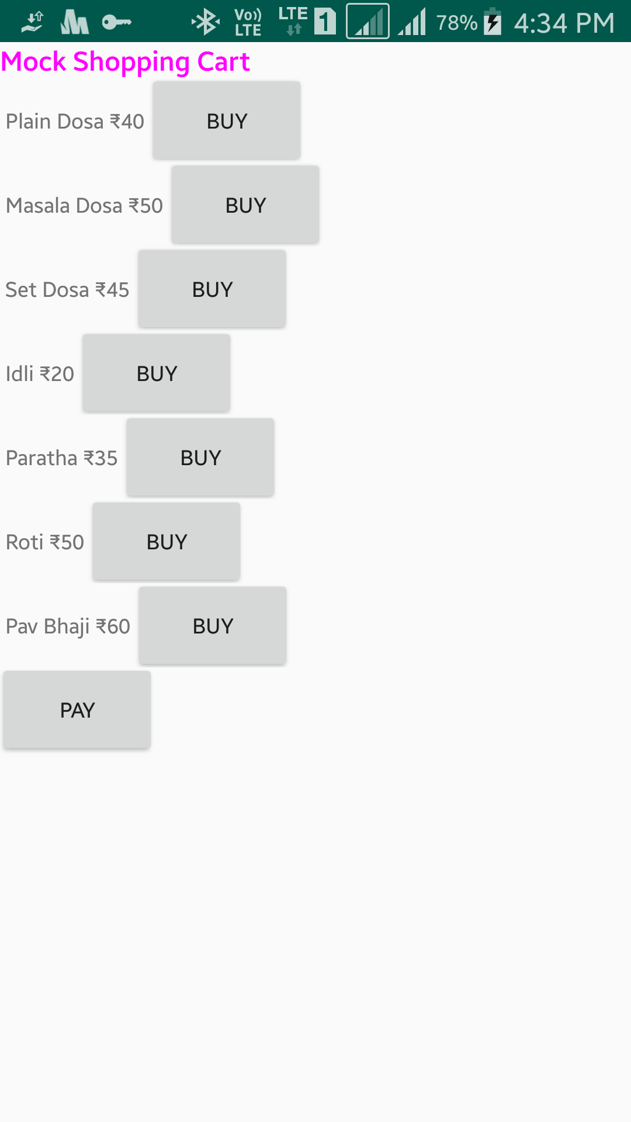
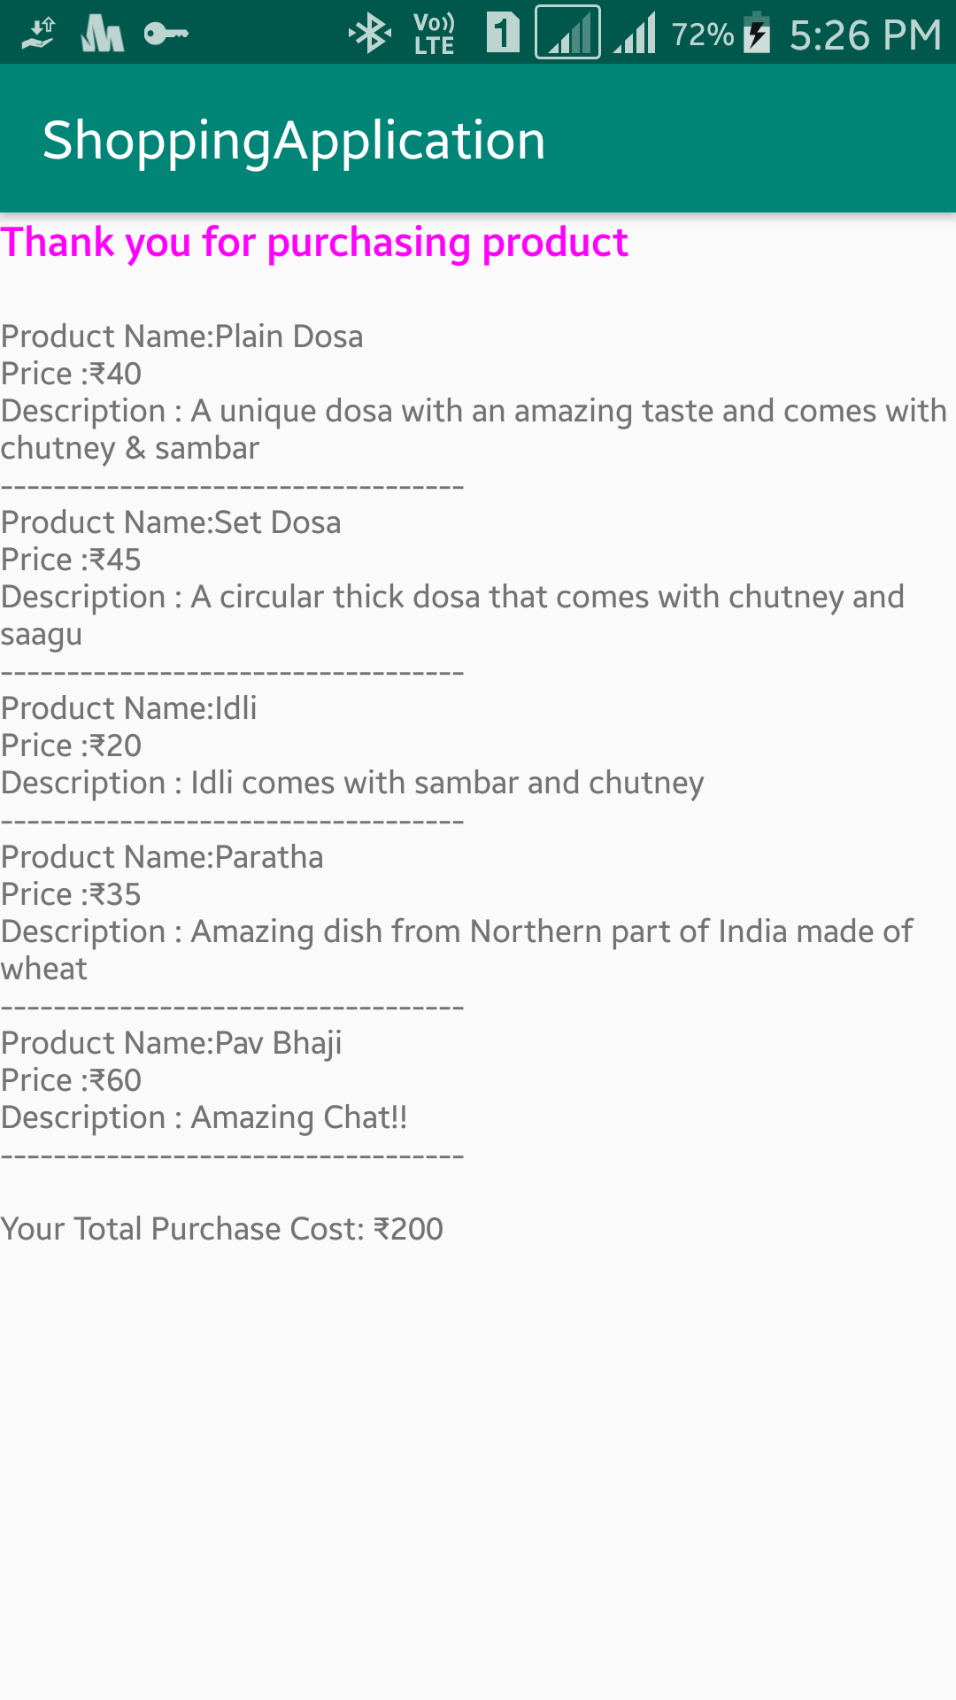
Shopping Application:
Home Page of Online Shopping
List of products purchased

Slide 19
Reflection Notes
Smartphones industry has seen a huge growth in recent years. This has increased the usage of android OS because of its attractive features. Android applications are being developed to meet all requirements of users.
Internship was helpful to get an exposure of android development with external database services like Firebase.
Learnt how to build good user interface using android studio.
Got good experience in handling databases, calling APIs and developing application functionalities in an industry standard manner.

